Slide 1
Advanced Deep Learning ZG513
Dr. Sugata Ghosal
sugata.ghosal@pilani.bits-pilani.ac.in

Slide 2
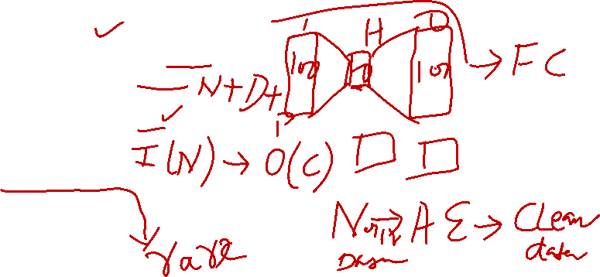
Agenda
Supervised vs Unsupervised Learning Experience
Autoencoders
Undercomplete AE
Regularized AE
Convolutional AE
Denoising AE
Sparse AE
Deep Autoencoders

Slide 3




In This Segment
Supervised vs Unsupervised Learning Experience Autoencoders
Undercomplete Autoencoders Regularized Autoencoders Convolutional Autoencoders Denoising Autoencoders Sparse Autoencoders
Deep Autoencoders
1
2
3
4
5
6
7
8

Slide 4
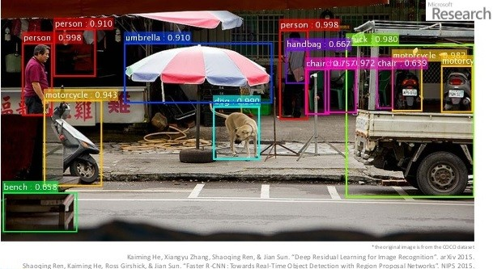
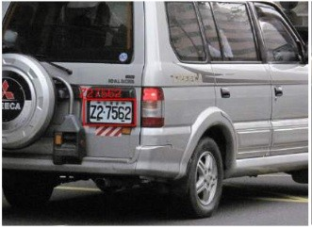
Supervised Learning
Data: m training examples (X, y ) X is the data and y is the label.
Goal: Learn a function to map data to the label. y = f (X )
Example Tasks: Classification,
regression, object detection, semantic segmentation,image captioning,etc.
Figure: Object recognition: He: Faster R-CNN
Figure: OCR: Hui Li, Wang, & Shen

Slide 5
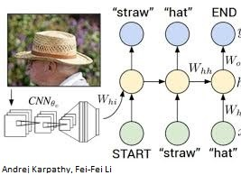
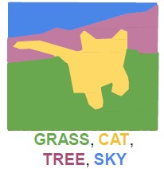
Supervised Learning
Data: m training examples (X, y ) X is the data and y is the label.
Goal: Learn a function to map data to the label. y = f (X )
Example Tasks: Classification,
regression, object detection, semantic segmentation,image captioning,etc.
Figure: Image Captioning: Andrej Karpathy, Fei-Fei Li
Figure: Semantic Segmentation

Slide 6
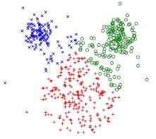
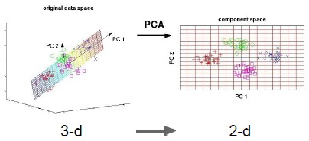
Unsupervised Learning
Data: m training examples (X )
X is the data. No Labels !!!
Goal: Learn some underlying hidden structure of the data.
Example Tasks: Clustering,
dimensionality reduction, feature learning, density estimation,etc.
Figure: k-means Clustering
Figure: Dimensionality Reduction

Slide 7
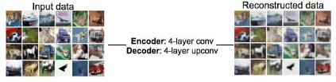
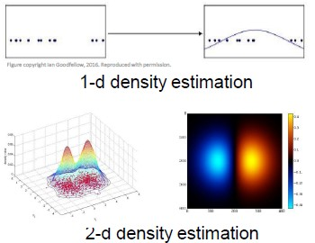
Unsupervised Learning
Data: m training examples (X )
X is the data. No Labels !!!
Goal: Learn some underlying hidden structure of the data.
Example Tasks: Clustering,
dimensionality reduction, feature learning, density estimation,etc.
Figure: Feature Learning using Autoencoders
Figure: Density Estimation

Slide 8
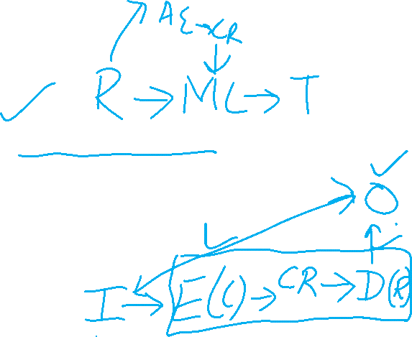
Autoencoders
Unsupervised experience.
Learns a lower-dimensional feature representation called code; from unlabeled training data.
The code can be used as features also. Autoencoders are efficient feature detectors.
Autoencoders perform dimensionality reduction. Trained to attempt to copy its input to its output.

Slide 9



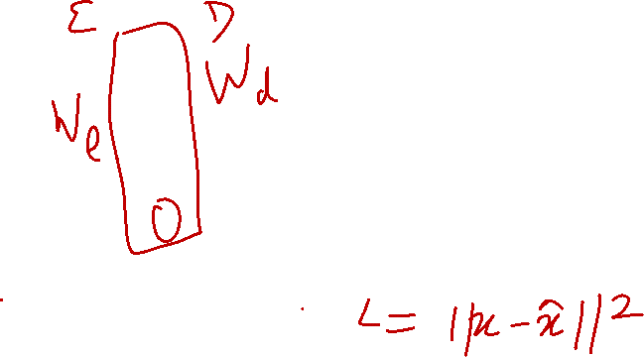
Autoencoder Architecture
Encoder
x₁
Hidden layer
Decoder
An autoencoder is a special type of feed forward neural network which does the following.
Encodes its input x_{i} into a hidden representation h.
Decodes the input again from this hidden representation.
The model is trained to minimize a certain loss function which will ensure that x^{ˆ}_{i} is close to x_{i} .
x^{ˆ}₁
x₂
h₁
x^{ˆ}₂
x₃
h₂
x^{ˆ}₃
x₄
h
x^{ˆ}
3
4
x₅
x^{ˆ}₅
h = f (W_{e}x_{i} + b) x^{ˆ}_{i} = g(W_{d} h + c)

Slide 10
Autoencoder Architecture
Feedforward deep neural network
Contains input layer, hidden layer and output layers.
The number of output neurons is exactly same as the number of input neurons
The hidden layer describes the code used to represent the input.
All techniques and optimizations of DNN are applicable.
Train the autoencoder such that features can be used to reconstruct original data.
Input layer
x₁
Hidden layer
Output layer
x^{ˆ}₁
x₂
h₁
x^{ˆ}₂
x₃
h₂
x^{ˆ}
3
x₄
h₃
x^{ˆ}₄
x₅
x^{ˆ}₅
h = f (W_{e}x_{i} + b) x^{ˆ}_{i} = g(W_{d} h + c)

Slide 11






Undercomplete Autoencoders
One hidden layer which has lesser units than input layer.
dim(h) < dim(x )
Input and output layers have equal number of neurons.
h is a loss-free encoding of x_{i} . It captures all important characteristics of x_{i} .
Hidden layer
Encoder
Decoder
xˆ₁
x₁
h₁
x₂
xˆ₂
h₂
x₃
xˆ₃
h₃
x₄
xˆ₄

Slide 12

Undercomplete Autoencoders
Components of Autoencoders
Encoder (recognition network)
converts input to code.
h = f (x ) = f (W_{e}x + b)
Code h has a smaller representation than input x .
Decoder (generative network)
produces a reconstruction.
xˆ = g(h) = g(W_{d} h + c) = g(f (x ))
Loss function
reconstruction loss which penalizes when outputs are different from input.
Mean squared error
L(x, xˆ) = ||x − xˆ||²

Slide 13



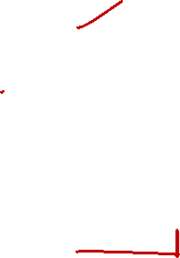
Undercomplete Autoencoders
Input data
x
^{h = f (x )} Encoder
Codes
h
x^{ˆ} = g(h) Decoder
Reconstructed input data
x^{ˆ}
Loss function
||x − x^{ˆ}||²

Slide 14
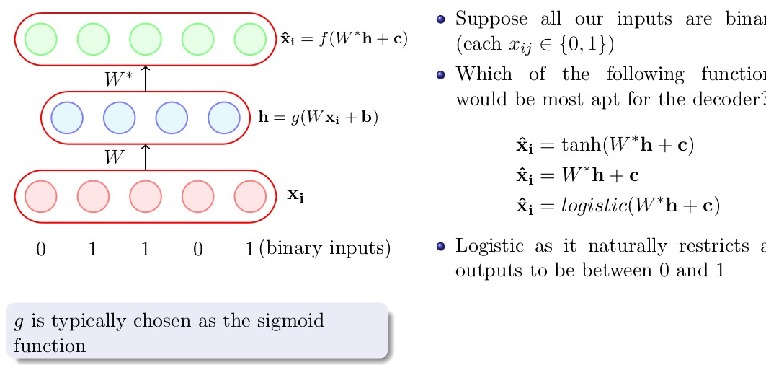
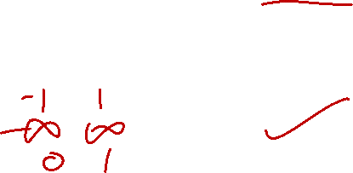

Slide 15
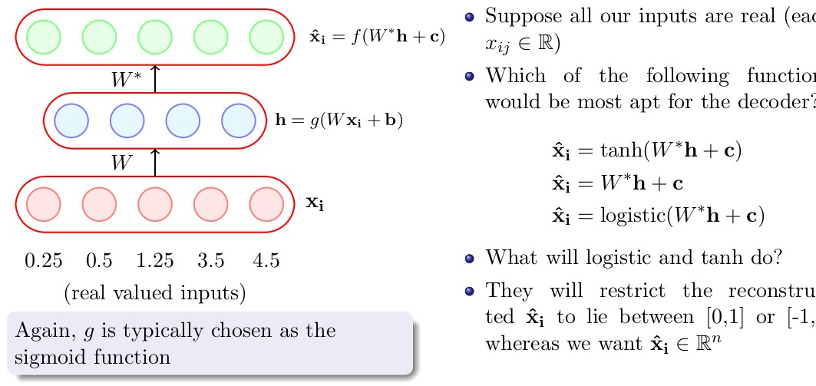
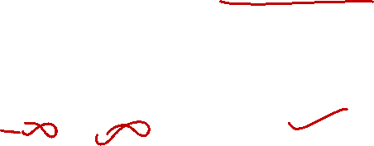


Slide 16
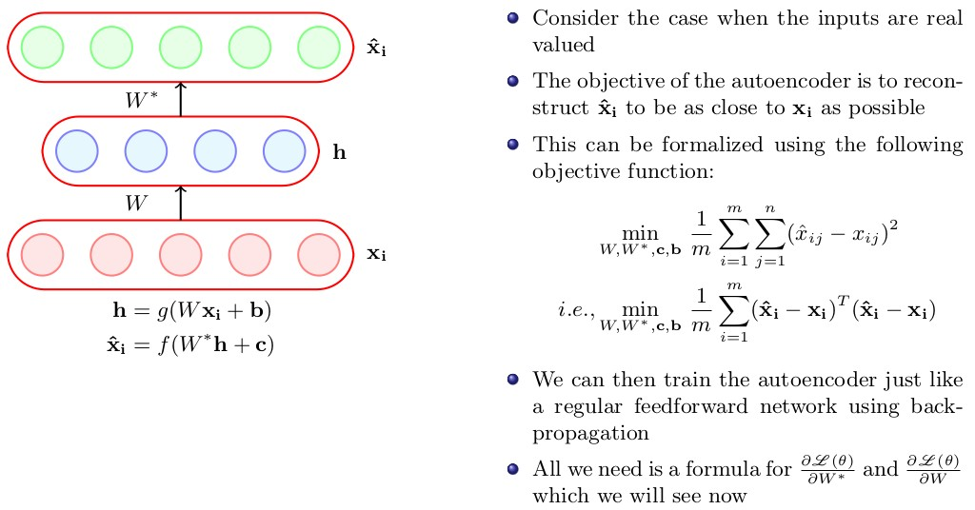
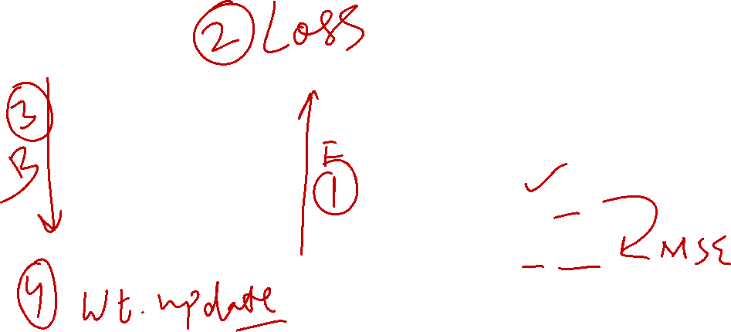
Autoencoders – Learning

Slide 17
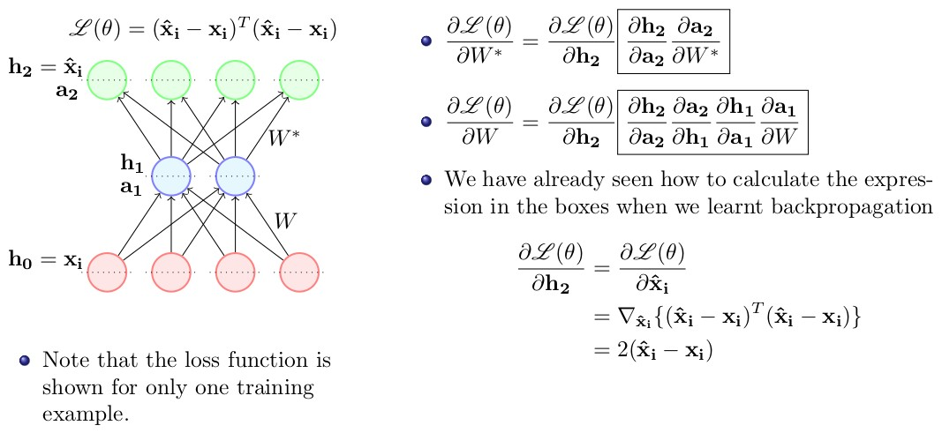

Autoencoders – Learning

Slide 18
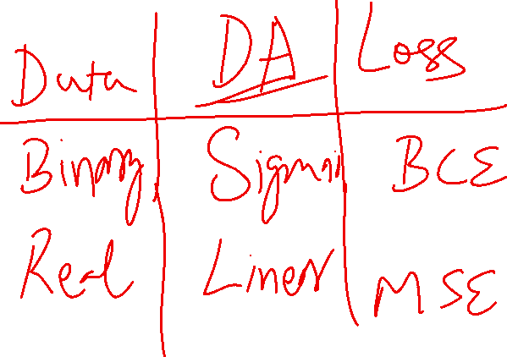

Slide 19
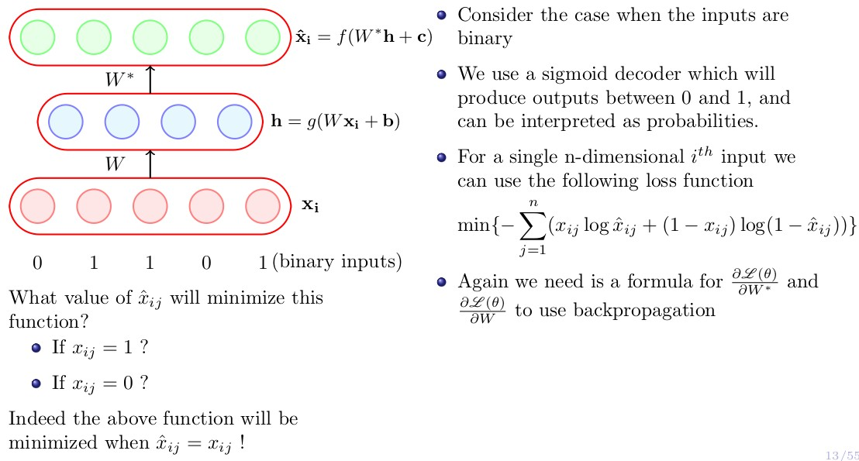
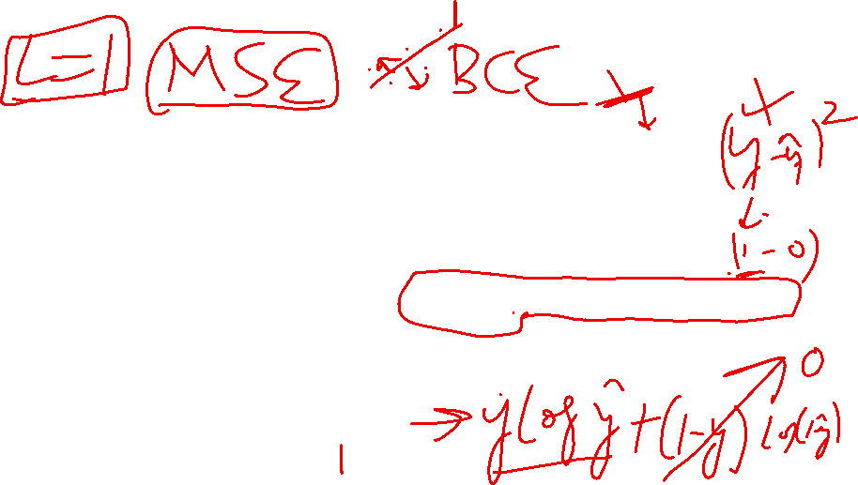
Autoencoders – Learning

Slide 20
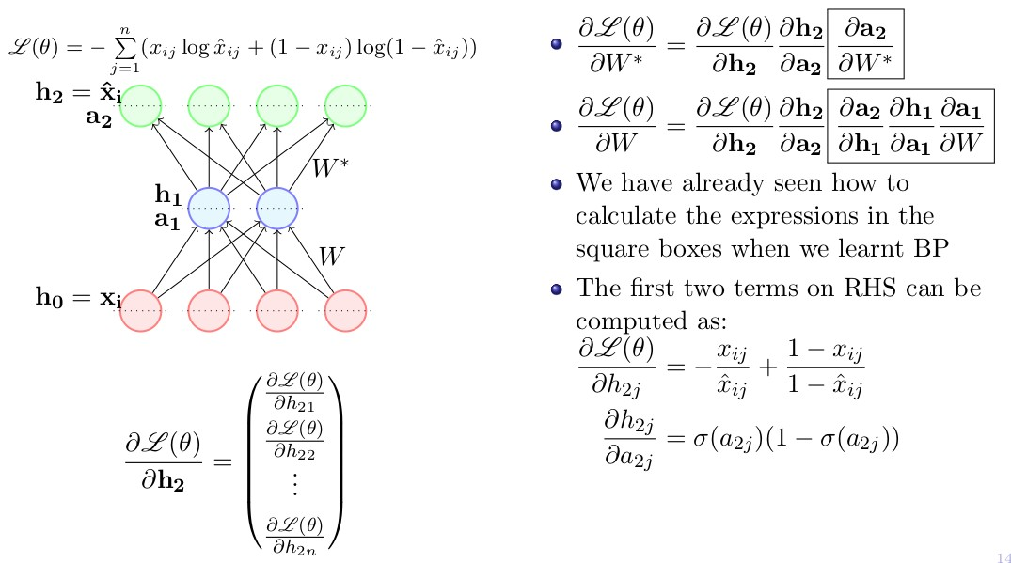
Autoencoders – Learning

Slide 21
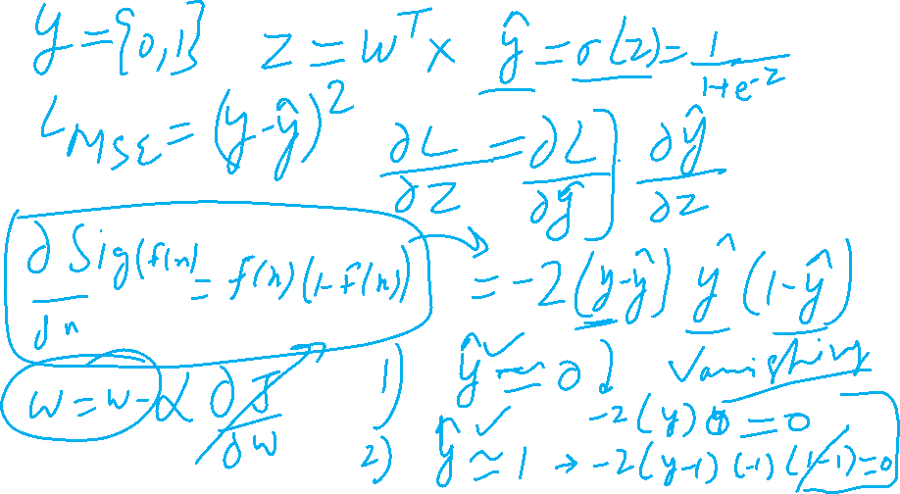

Slide 22
